Slide 1
Online food delivery website
Submitted by:-
Ujjawal Raj Singh
Pranjal Kushwaha
Shobhit kasana
Ajay yadav
SUBMITTED TO:-
DR. POORNIMA TYAGI

Slide 2
Project Introduction
Hardware and Software Requirement
Website View
Business Model & SWOT
Core Competency
Future Aspects
Conclusion
CONTENTS

Slide 3
PROJECT INTRODUCTION
Genuine Name- FOODIE HUNTER
Positioning-FOODIE HUNTER provides you the “guide” or the “discovery” experience of restaurants & food guide.
Category-Website Platform
Sector- Food & Restaurant Guide

Slide 4



Hardware & Software requirements
HARDWARE
Personal Computer
Smartphone
SOFTWARE
Google Chrome
Scripting Languages- HTML, CSS, JS

Slide 5
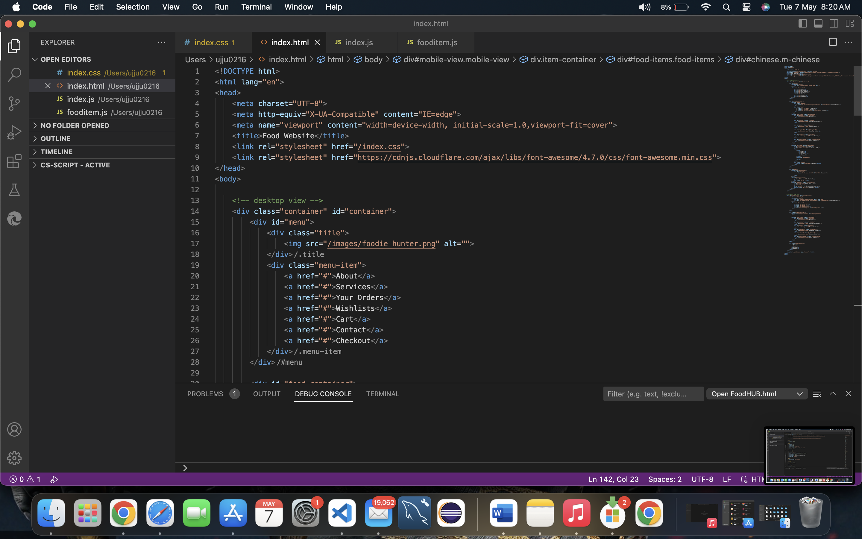
SOURCE CODE
Index.html

Slide 6
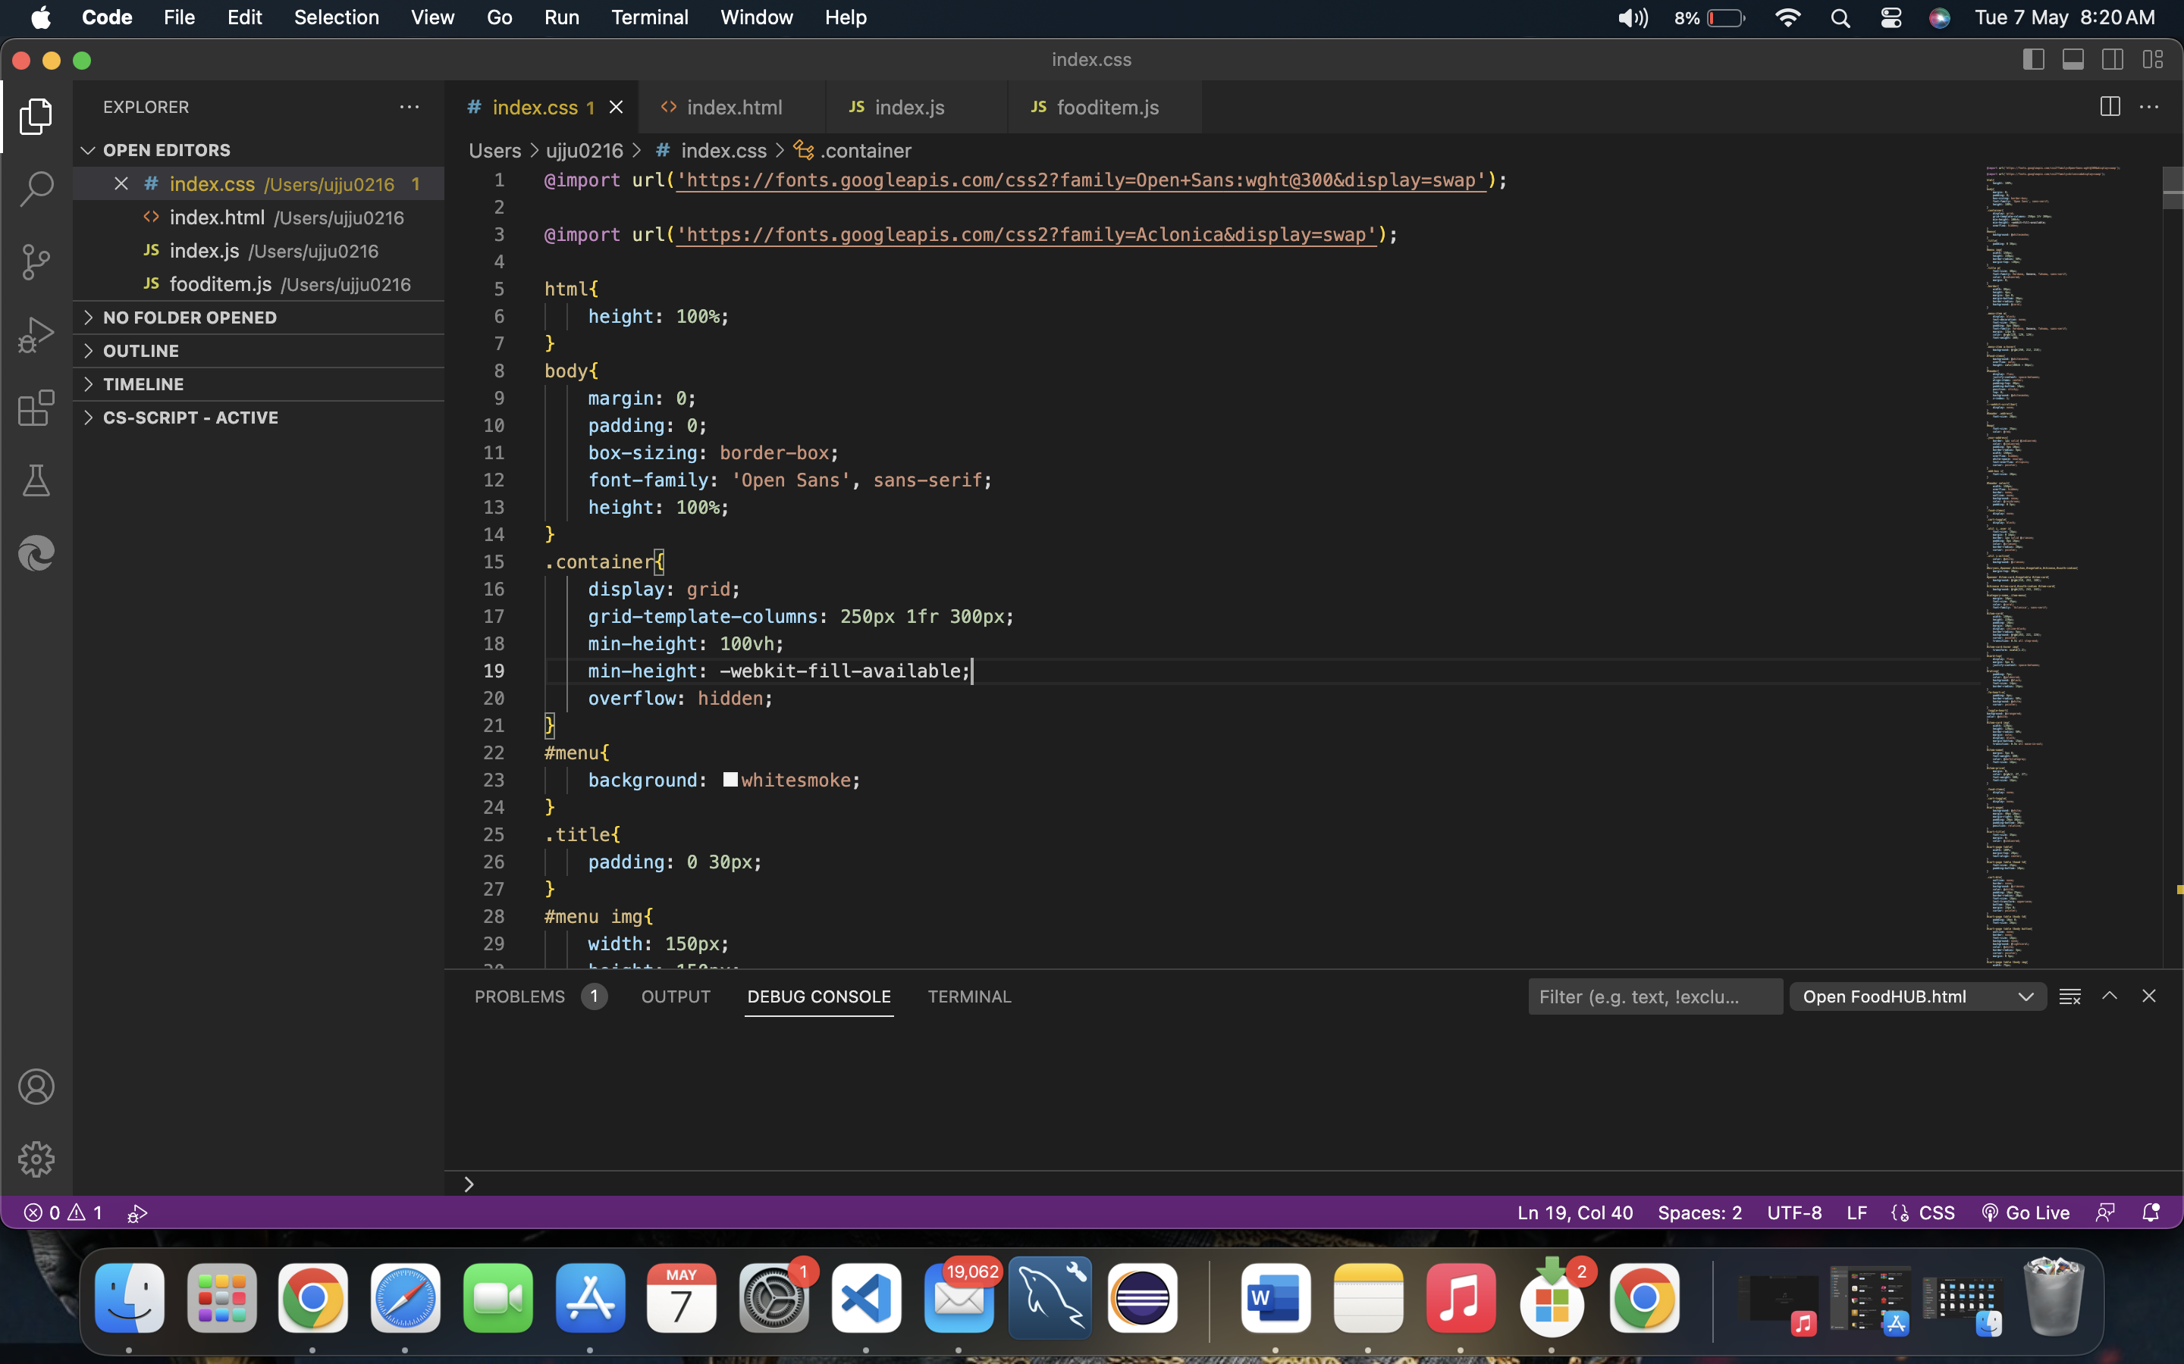
index.css

Slide 7
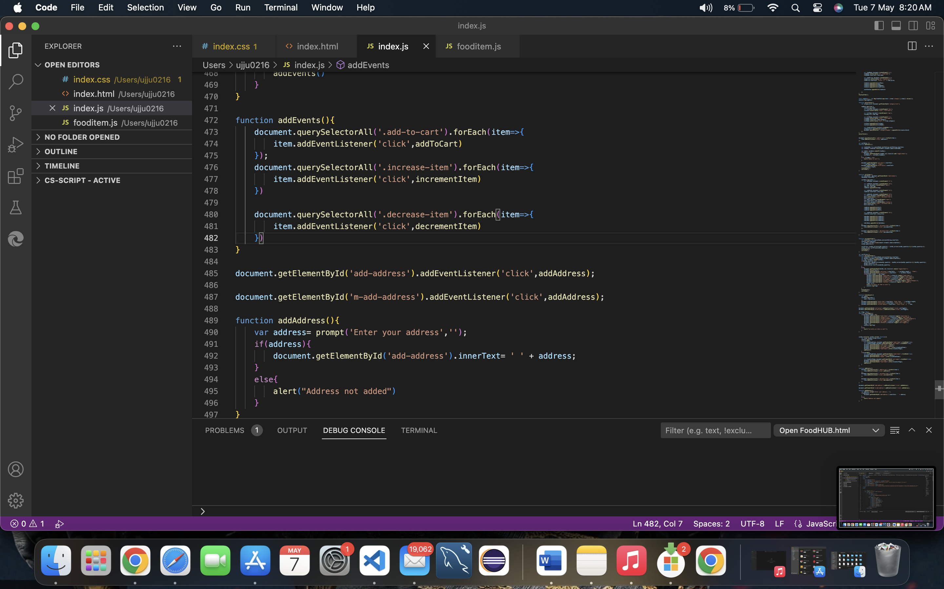
index.js

Slide 8
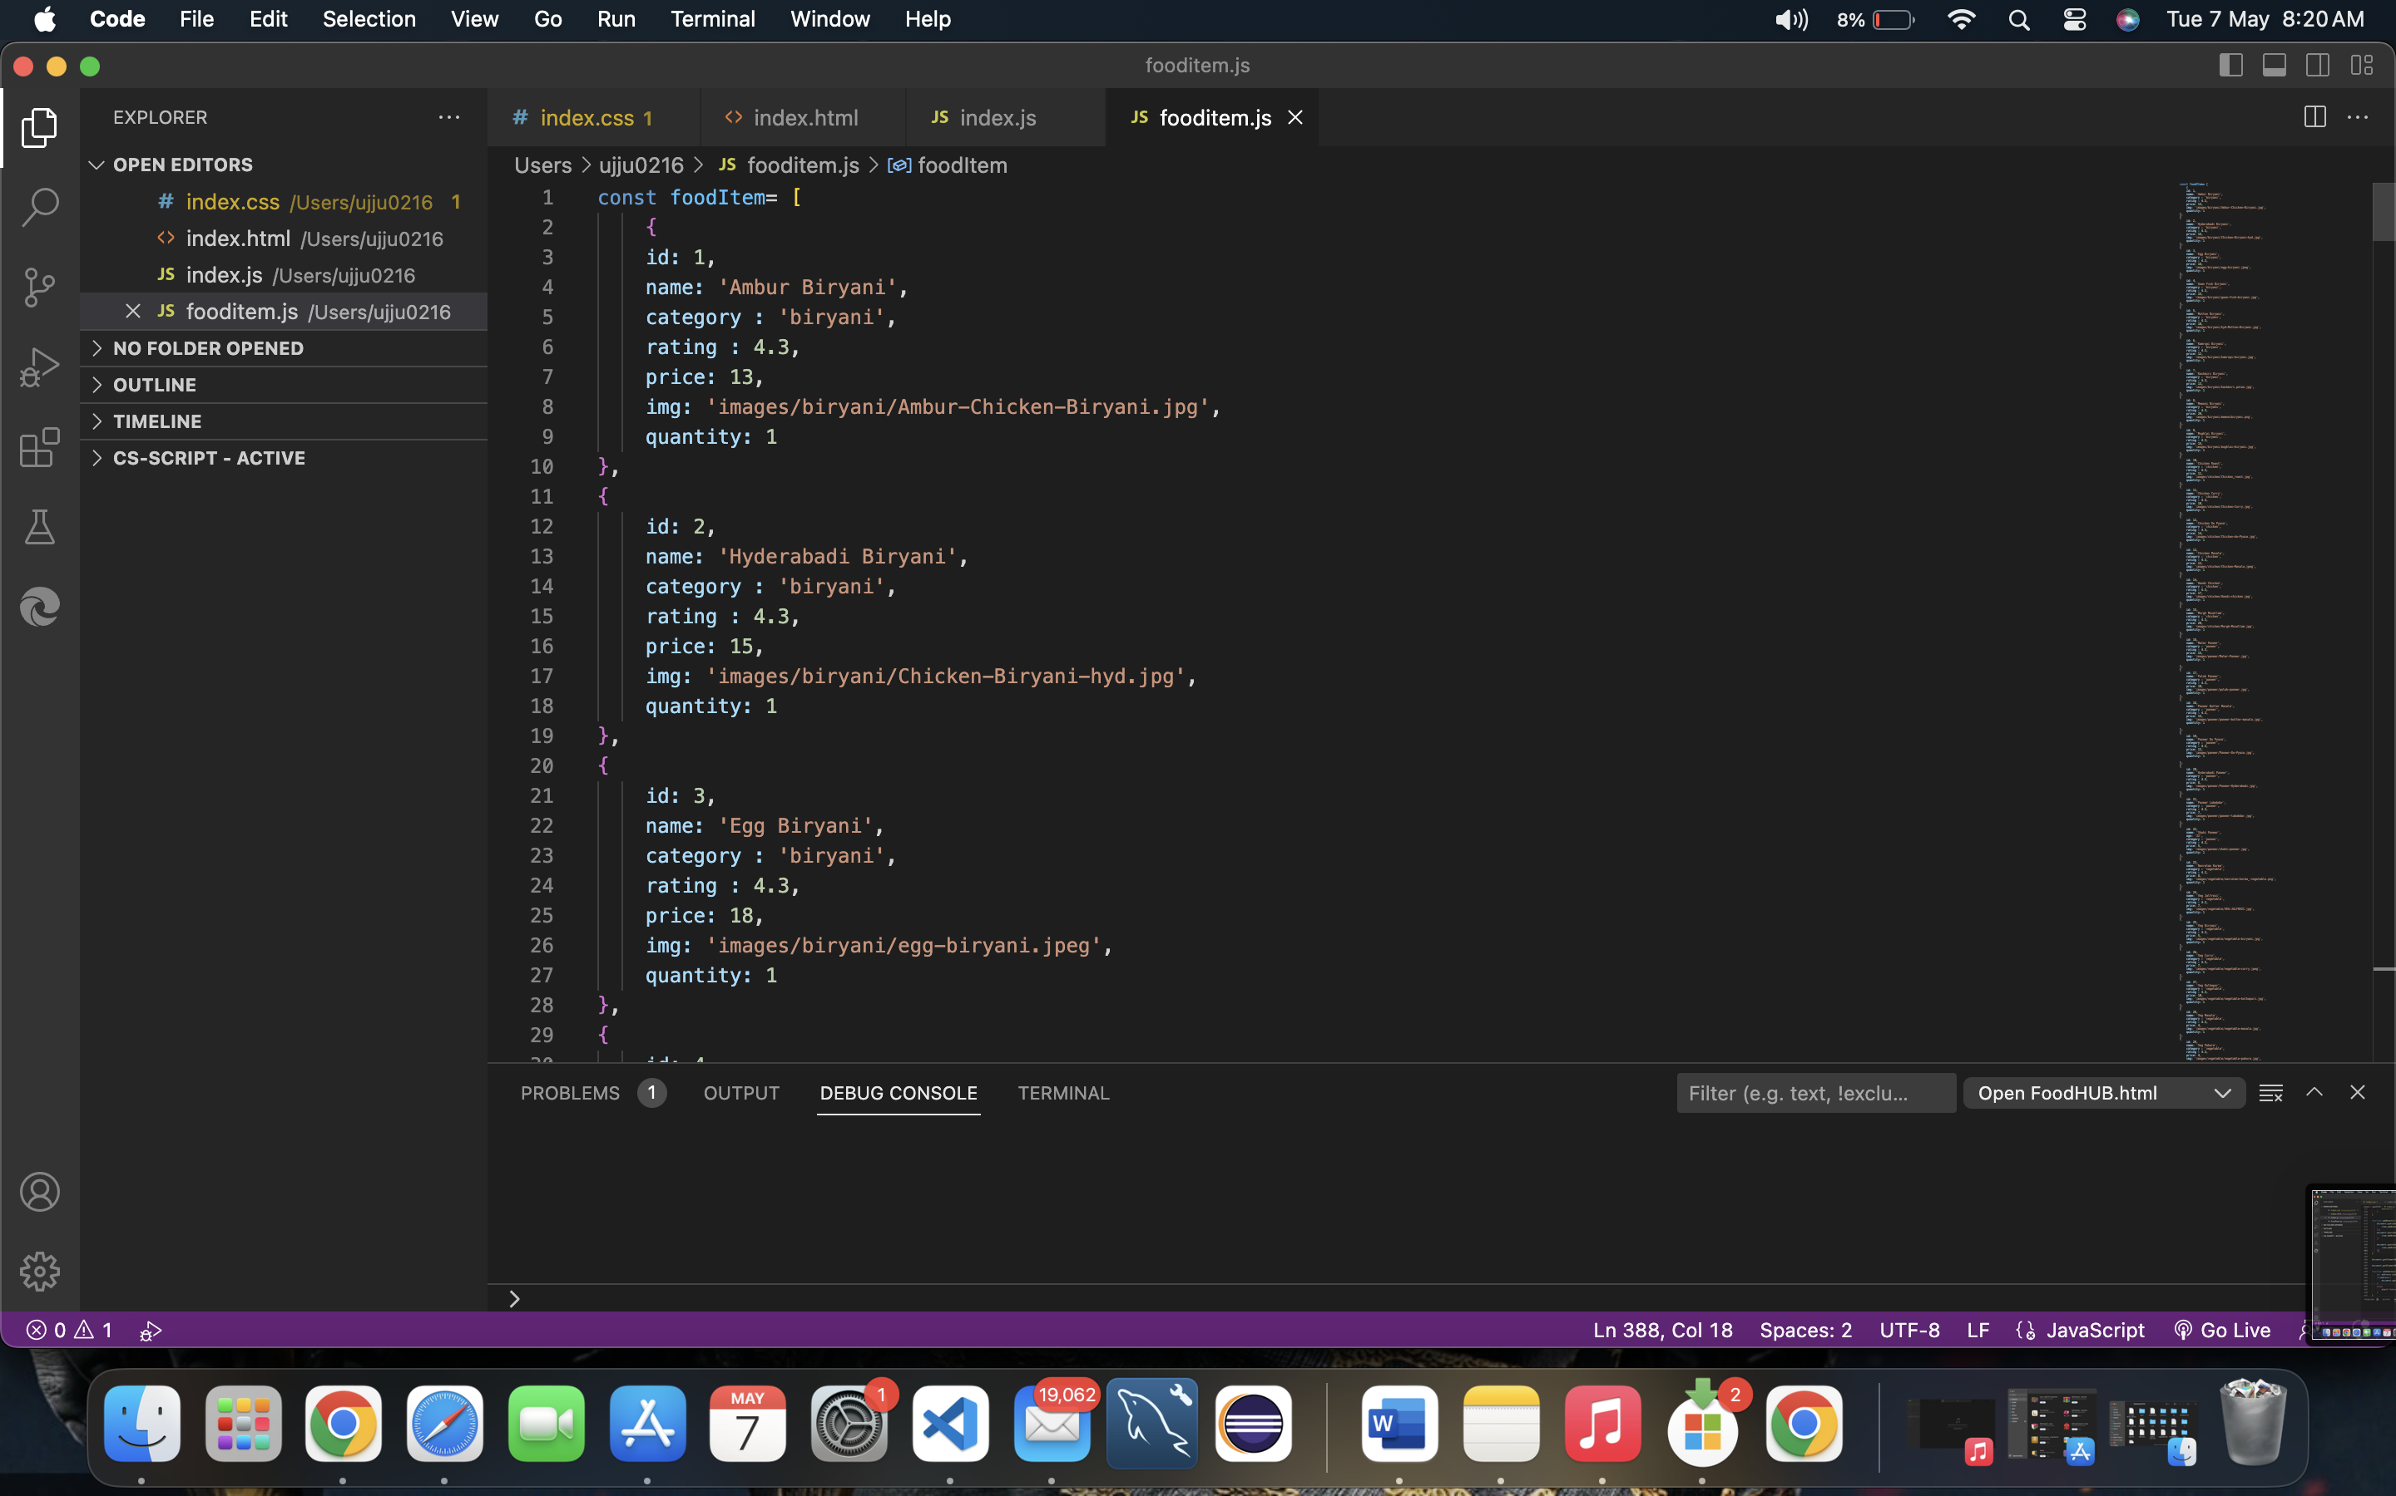
fooditems.js

Slide 9
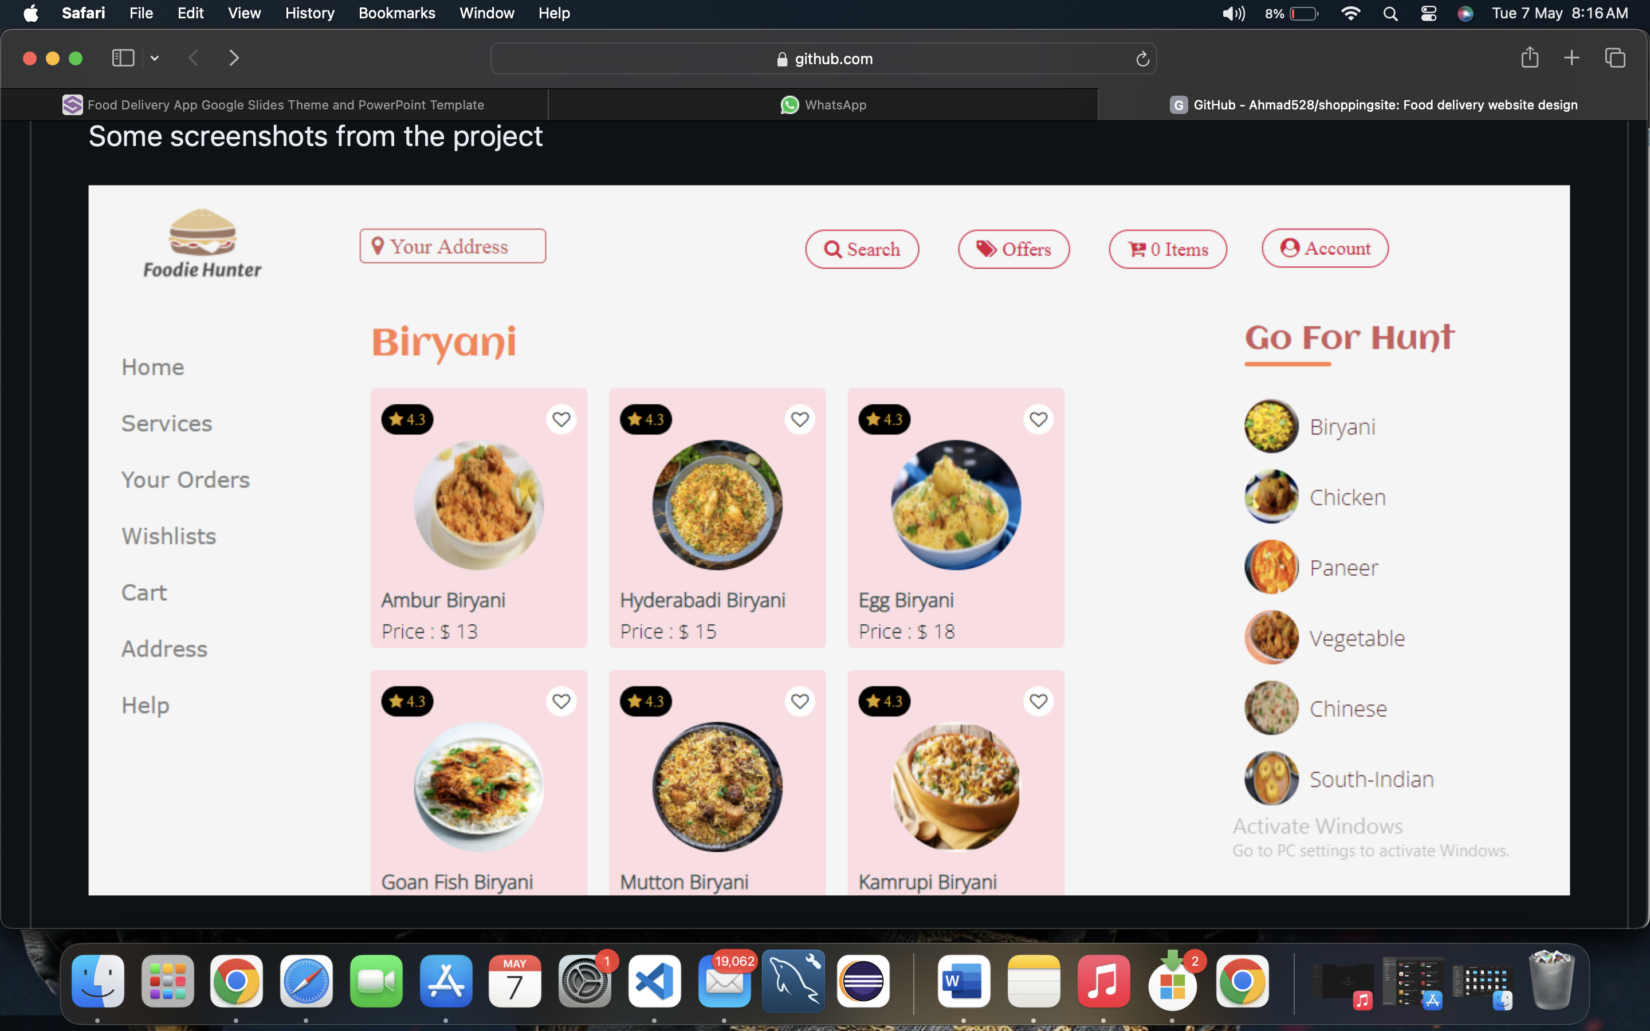
WEBSITE VIEW
MENU VIEW

Slide 10
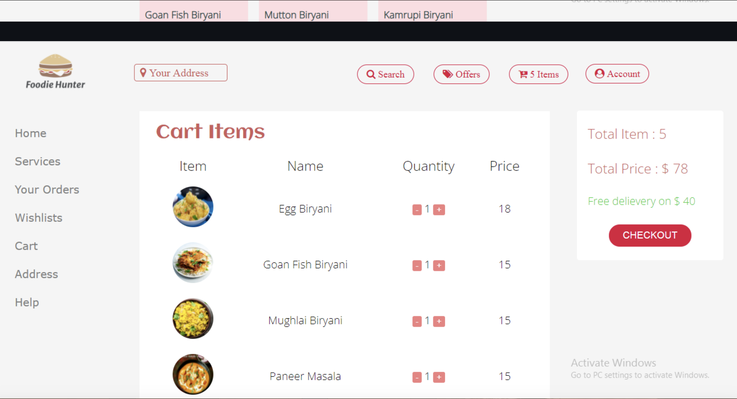
CART VIEW

Slide 11
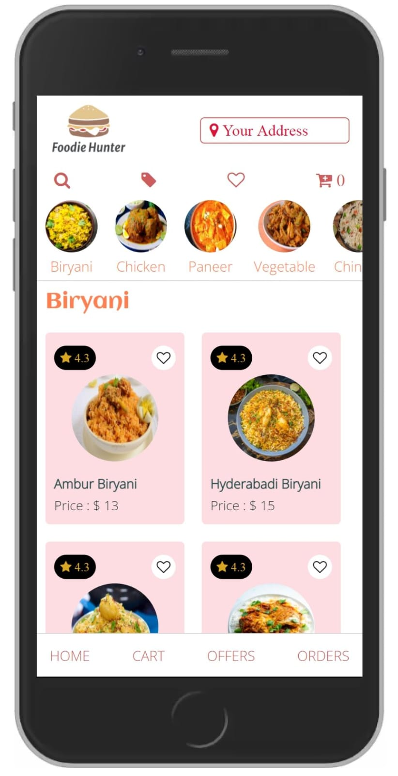
MOBILE VIEW

Slide 12
STRENGTH
User perceive FOODIE HUNTER as ‘ Speciality product’(Focused only on foods and restaurants)
High Awareness- Top of mind product.
Superior Technology and a strong workforce of over peoples.
Simple and user friendly interface.

Slide 13

weakness
Competition from search engines & other similar apps means limited growth.
Drastic growth means susceptible to bad content.
Not customized for each target market.
Work inefficiency.
High Staff turnover.

Slide 14

Future aspects
First mover advantage.
Strong Content Platform(SCP).
Efficient Employees.
Good rating mechanish and social platform.

Slide 15
Refrences
Wikipedia
Quora
Linkdin
Zomato Blogs

Slide 16
Thank you
THANK YOU

